Slide 1
Chapter03 IP Addressing
Session 02
DNS Server

Slide 2


OBJECTIVES FOR TODAY
Understanding how DNS server work
Identify the important of DNS server for web development
Explain how DNS Name resolution work

Slide 3



ENGAGE
Remember these IP addresses
2 MIN
216.58.196.14
=> www.google.com
118.67.200.220
=> www.facebook.com
192.168.107.8
=> kampotsd.pnc.lan
Notes:
Life without internet would be like:
No internet-communication (e-mail, messenger, social media ...)
Effect on Business (online store, e-commerce, making money online …)
Access to information & resource cut (education, entertainment…)

Slide 4

What is DNS Server?

Slide 5

EXPLORE
How do you access to any website?
5 MIN
What is website address (URL) use for?
In network communication, URL cannot use as destination.
IP address is the only destination that used in network communication.

Slide 6

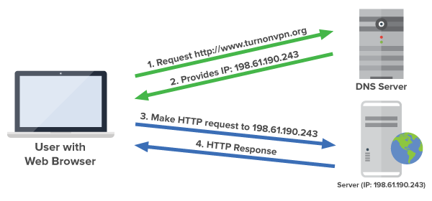
EXPLAIN
DNS Server
5 MIN
DNS (Domain Name System) is the phonebook of the Internet.
When user type domain name (URL) into browser, DNS is responsible for translating those domain name to IP address, leading them to the correct website.
Notes:
When users type domain names such as ‘google.com’ or ‘nytimes.com’ into web browsers, DNS is responsible for finding the correct IP address for those sites.

Slide 7


Used DNS protocol and UDP/TCP port 53.
What protocol and port that DNS Server use?
Notes:
When users type domain names such as ‘google.com’ or ‘nytimes.com’ into web browsers, DNS is responsible for finding the correct IP address for those sites.

Slide 8
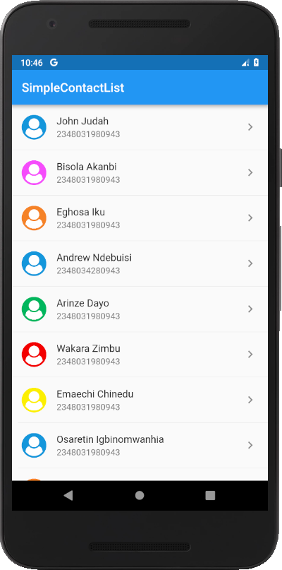
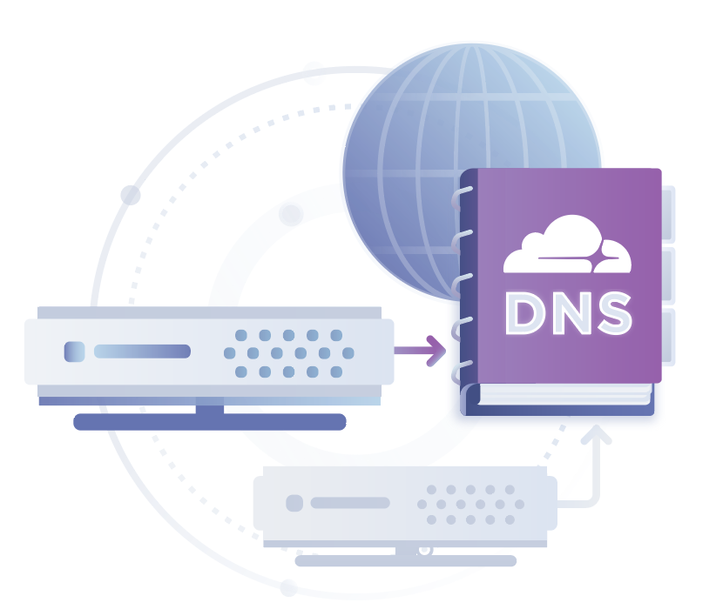

EXPLAIN
5 MIN
Phone Contact List
208.65.153.238 = youtube.com
157.240.15.35 = facebook.com
142.250.199.46 = google.com
205.251.242.103 = amazon.com
103.102.46.114 = timetables2.pnc.passerellesnumeriques.org
162.215.118.3 = www.puthisastra.edu.kh
DNS is the phonebook of the Internet.

Slide 9
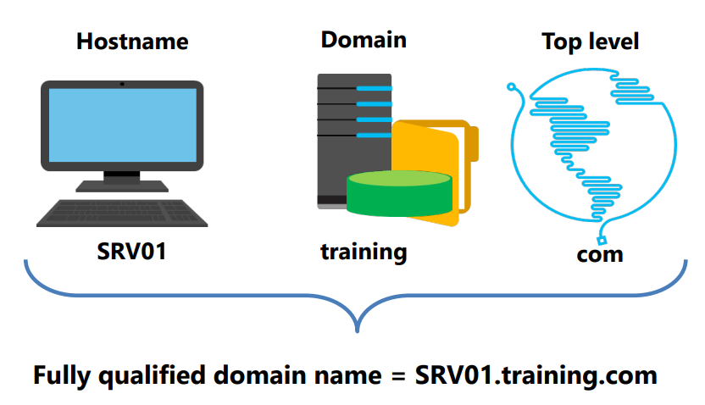
EXPLAIN
Domain Name Structure
5 MIN
Domain names are organized into a tree-like structure, with :
Top-level domains (TLD)
Second-level domains (SDL)
Subdomain (Hostname)
Notes:
- Explain each element to student : Top-level domain, second-level domain, subdomain

Slide 10
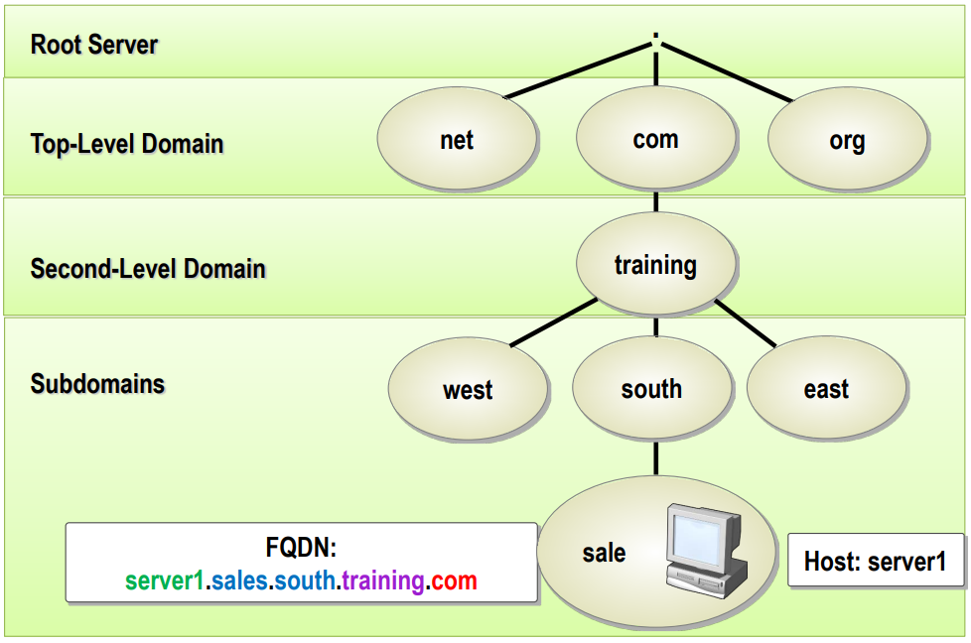
EXPLAIN
Domain Name Structure
5 MIN

Slide 11

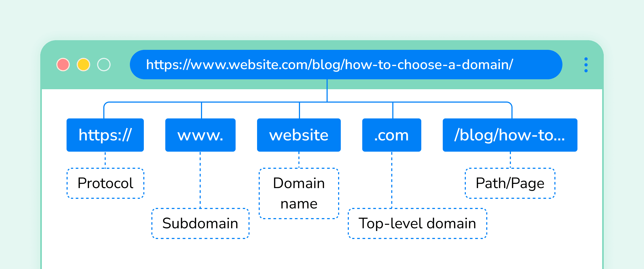
EXPLAIN
Domain Name Structure
5 MIN

Slide 12

ACTIVITY
ACTIVITY 1
5 MIN
Identify the DNS Structure below:
www.news.sportclub.com.th
cat.blog.myjurney.com
cambodia.passerellesnumeriques.org
Notes:
- Let student identify each part of the URL (TLD, SDL, subdomains).

Slide 13

DNS Name Resolution

Slide 14
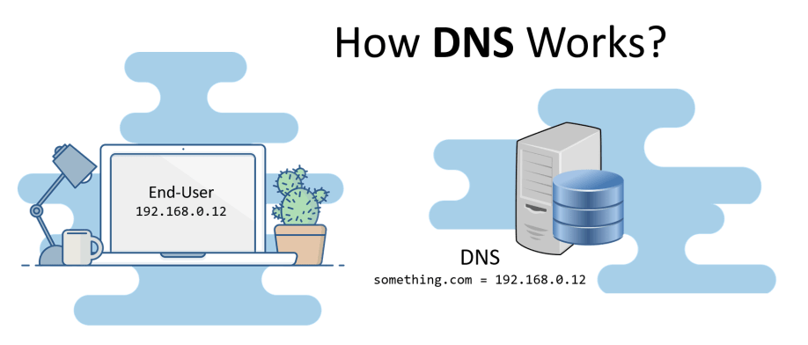

Slide 15
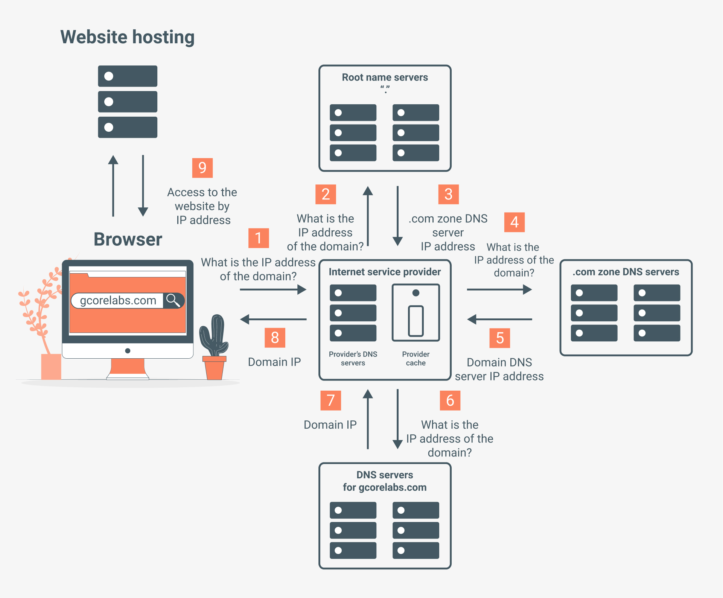
DNS Name Resolution Process

Slide 16
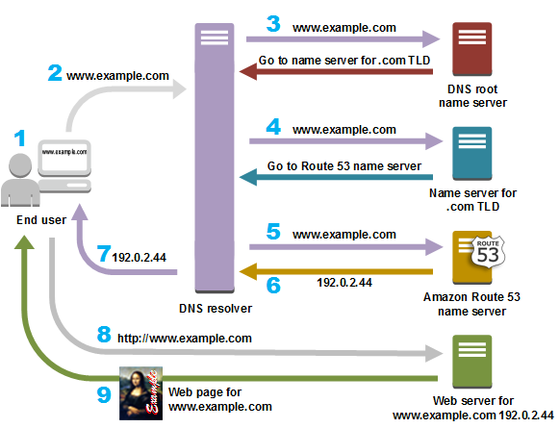
EXPLAIN
DNS Name Resolution Process
5 MIN
Components in this communication:
DNS Resolver (Local DNS / ISP)
Root Name Server
.com TLD Server
Amazon Route 53
Web Server

Slide 17

Public DNS Server

Slide 18

EXPLORE
5 MIN
Who can give you the domain name?
How can we buy a domain name?

Slide 19






EXPLAIN
Domain Name Providers
5 MIN

Slide 20

EXPLAIN
How to register public domain name ?
5 MIN
You need to :
Have your credit cards (Master card / Visa Card … )
Select you favorite Domain Name provider
Create account for login to provider website
Choose your favorite domain name and available
Process payment

Slide 21


DEMO
5 MIN
Buying a Domain Name!
Notes:
Ask student to work in group of two and discuss about the different way to get access to internet.
Let student choose the best internet solution for each network size.

Slide 22


